Slide 1

Solar Energy Harvesting Device
For Xylem Water Meter
EE494

Slide 2
PRESENTORS
Siddhant Khera –– Report Compilation and Electrical Design Development & Production, General Management
Serena LaFave –– Report Writing, Soldering and Prototyping
Krystal Bakr –– Managing Technical Documentation, Project Financials and Research

Slide 3
Today’s Agenda
Executive Summary
Why Solar?
Conceptual Model: Initial to Final
Components: Solar & Battery
Final Schematic Custom PCB Design
Drawbacks of Current Design
Enclosure Details
Bill of Material
Note on Ethics
Conclusion & Future Work

Slide 4
Executive Summary
An energy harvesting system for a Xylem water meter, using Li-ion and Solar
Designed a custom PCB, measures only 33mm x 22mm
Battery storage provided for up to 37 days at 5mW peak power
Max dimensions 84mm x 59mm x 33mm, under the 100mm x 100mm x 60mm requirement
Manufactured BOM at $2.92, under $3 target set by Xylem
Environmental and other factors considered, Ethical sourcing most important
Unable to meet Ethical sourcing requirement due to cost
Environmentally: recyclable material used, up to 60% parts fully recyclable

Slide 5
Energy Harvesting Technology
Options include:
Thermoelectric
Solar
Hydroelectric

Slide 6
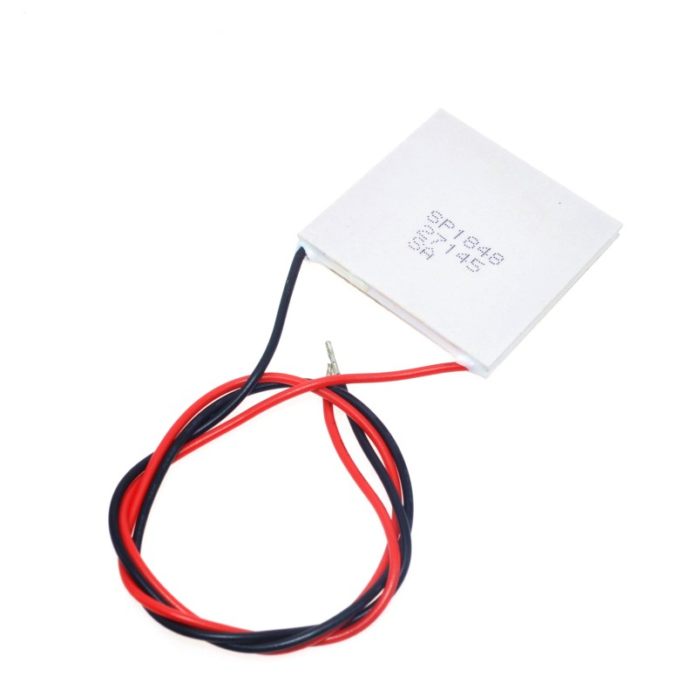
Thermoelectric
Works from a temperature difference [1]
At least 40°C difference needed [1]
Same ambient temperature
Battery heat
Fig 1: Thermoelectric Generator [2]
Notes:
40 deg diff: http://vi.raptor.ebaydesc.com/ws/eBayISAPI.dll?ViewItemDescV4&item=152641213248&category=181723&pm=1&ds=0&t=1555920406000&ver=0
pic: https://www.makerlab-electronics.com/product/thermoelectric-power-generator-module-teg-sp1848-27145/

Slide 7
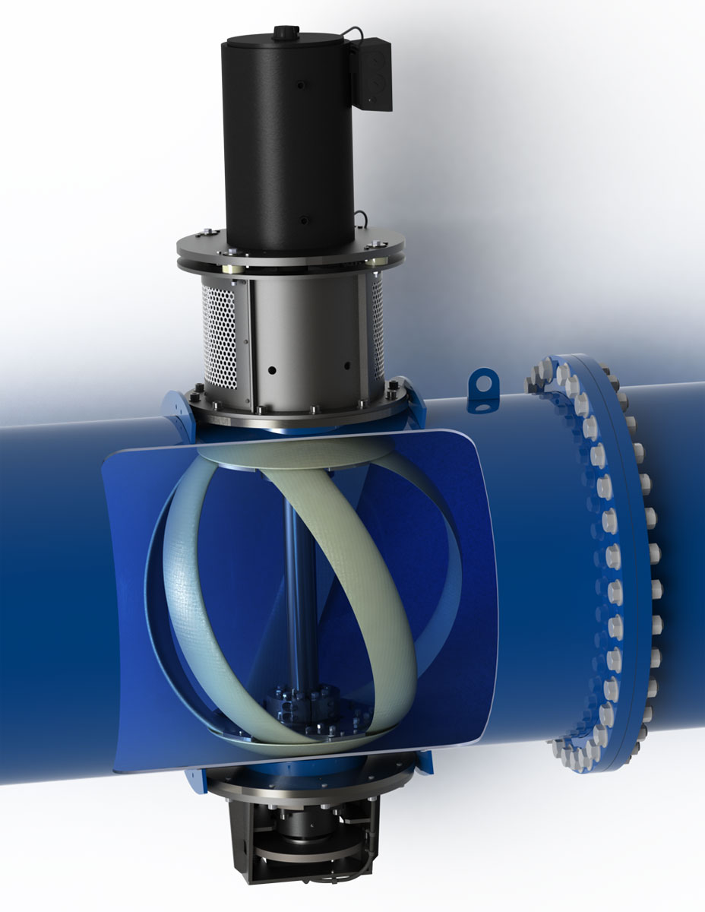
Hydroelectric
Difficult installation
Maintenance
Fig 2: In-Pipe Hydroelectric System [3]
Notes:
pic https://reprogrammingthecity.com/generating-power-from-city-water-infrastructure/

Slide 8
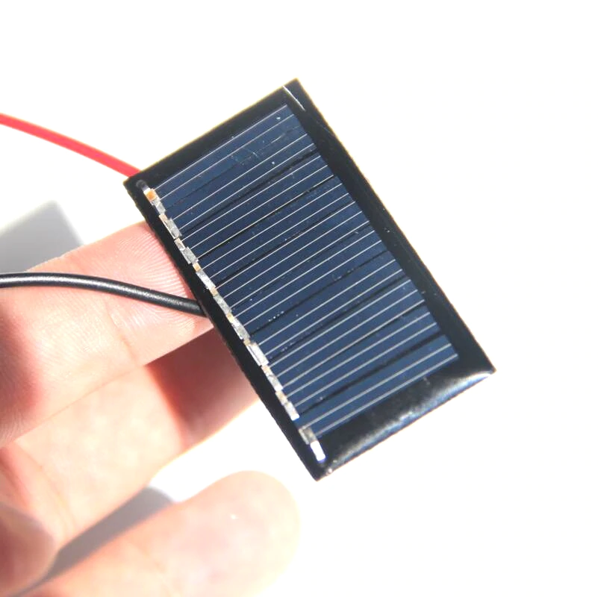
Solar
Readily available
Small size
Inexpensive
Yuma, Arizona: A very sunny place!
Fig 3: Solar Panel [4]
Notes:
pic https://www.aliexpress.com/item/32827162063.html

Slide 9
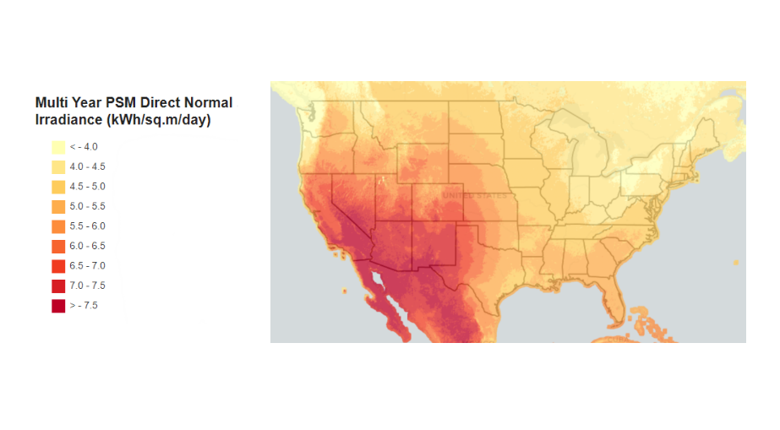
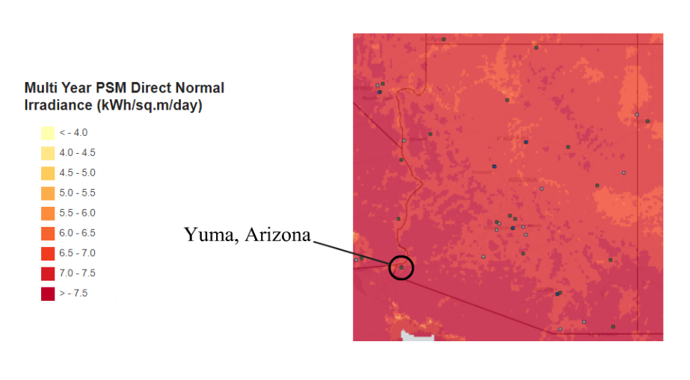
Fig 4: DNI Map of the US [5]
Yuma, Arizona
Fig 5: DNI Map of Arizona [5]
Notes:
pic https://maps.nrel.gov/nsrdb-viewer/?aL=0&bL=clight&cE=0&lR=0&mC=4.740675384778373%2C22.8515625&zL=2

Slide 10
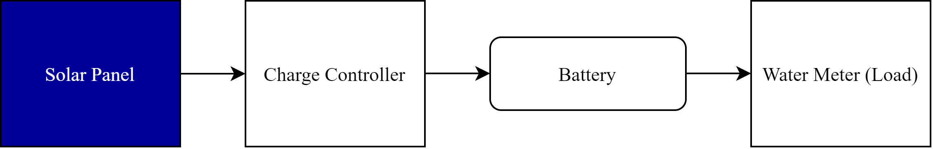
Conceptual Model: Initial
In the preliminary stages of our project, we designed a conceptual model that represented the basic concept of what we believed our design should do in order to accomplish the main goal of harvesting energy for the water meter.
5V to 5.5V Solar panel
Charge Controller
3.7V Li-Ion Battery
Water meter
Fig 6: Initial Conceptual Model [8]

Slide 11
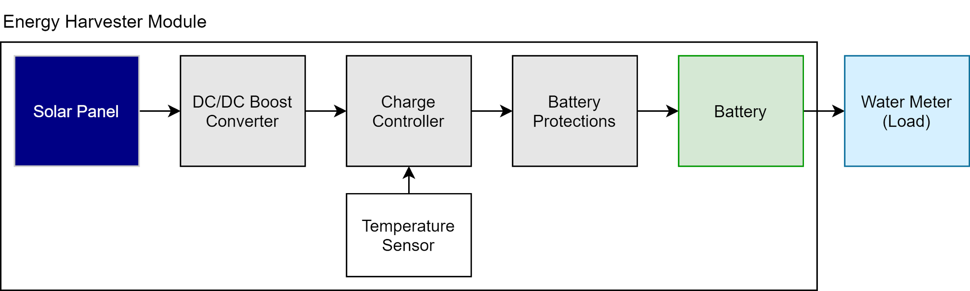
Conceptual Model: Final
Fig 7: Final Conceptual Model [8]

Slide 12
What did we change?
Added a DC-DC boost converter
Change in charge controllers
MCP → TP4056
Temperature control
NTC thermistor, new feature given our new charge controller
Low temperature protections
Battery Protection
DW01A chip
Adds overcharging, over discharging, and overcurrent protection to the battery
Notes:
Section 6.5.5 from Final Report

Slide 13
Components
Fundamental Components:
Battery
Solar panel

Slide 14
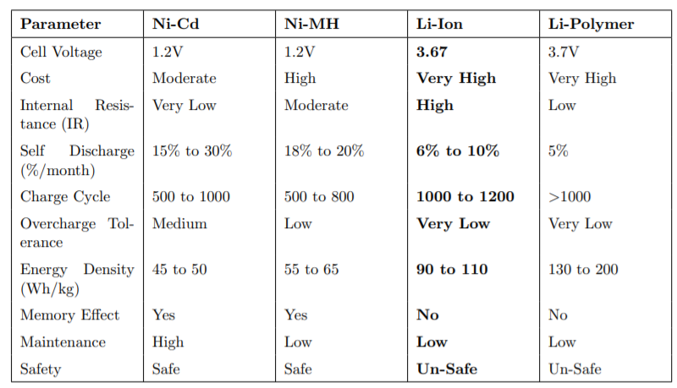
Components: Battery
Battery Technology: Lithium-ion
Standardized voltage that fit out needs
High charge cycle and energy density
No memory effect
Readily available in standard sizes, low cost
Table 1: Battery Technologies [8]

Slide 15
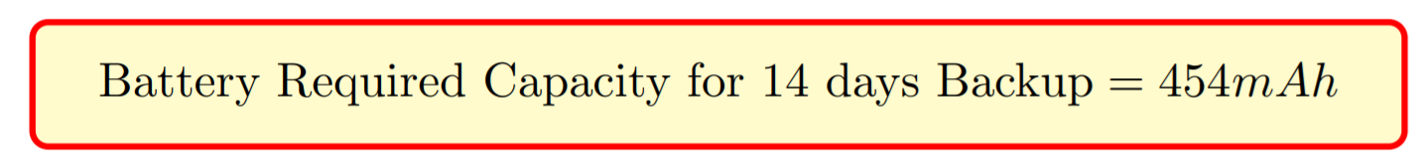
Components: Battery
Battery size
Calculations show that 454 mAh of battery storage = 14 days
Fig 8: Battery Calculation Result [8]

Slide 16
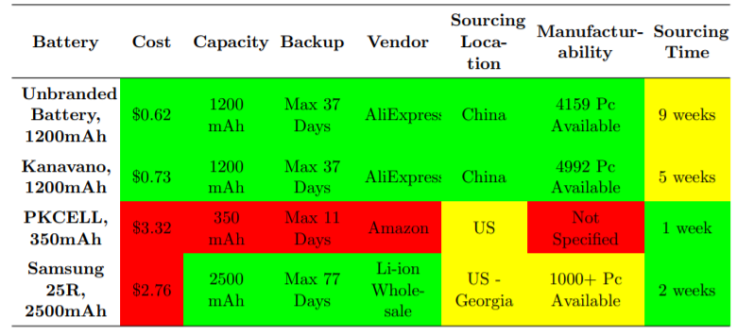
Components: Battery
Tie between Unbranded and Kanavano
Tiebreaker: Cost
Table 2: Battery Decision Matrix [8]

Slide 17
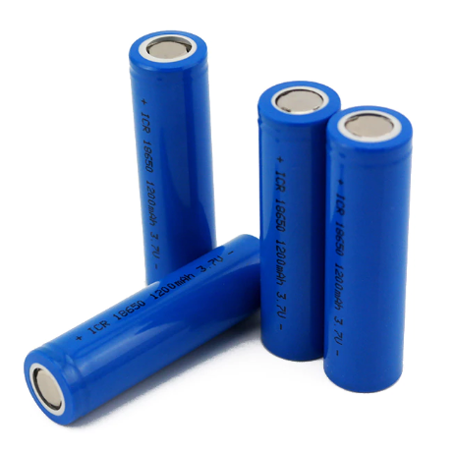
Components: Battery
1200mAh = Up to 37 days
Only $0.62
Fig 9: Final Battery Choice [9]
Notes:
battery pic: https://www.aliexpress.com/item/32893018458.html?spm=a2g0o.cart.0.0.50683c001kuDRz&mp=1

Slide 18
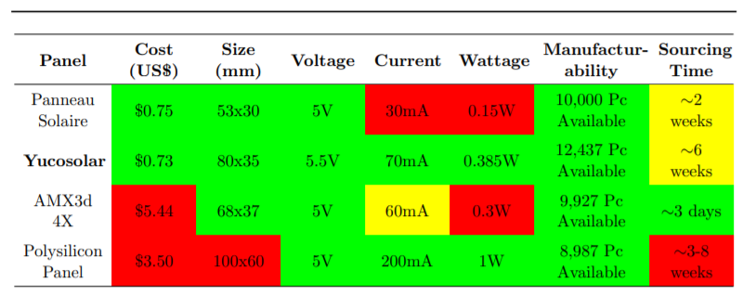
Components: Solar Panel
Original solar panel (Interim Design Report): 5V, 60mA
Designed the circuit around these values
Size
Table 3: Solar Panel Decision Matrix [8]

Slide 19
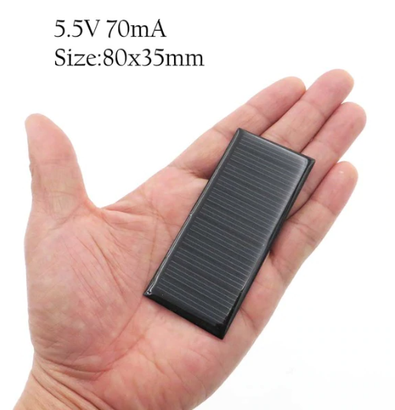
Components: Solar Panel
Final choice: Yucosolar
5.5V, 70mA
0.385W
~3.12h to fill battery
$0.73/unit
Fig 10: Yucosolar Panel [10]
Notes:
solar panel: https://www.aliexpress.com/item/33009866599.html?spm=a2g0o.productlist.0.0.2b1f6593YIFY2Q&algo_pvid=9768576c-2208-451a-8873-919287d6f879&algo_expid=9768576c-2208-451a-8873-919287d6f879-6&btsid=0be3764315892259202404537e31a7&ws_ab_test=searchweb0_0,searchweb201602_,searchweb201603_

Slide 20
Final schematic
Uses MT3086 (DC-DC Boost converter), TP4056 (Li-ion Charging Chip), DW01 (Li-ion battery protection)
Motivation to use MT3068 was to circumvent the low voltage issue from solar panel
Solar panel minimum under non-bright situations in 2.3V
MT3608: DC-DC Boost converter, Input required 2V, output constant 4.5V
TP4056: Min VCC = 4.0V, input is output from MT3608, connects to DW01
DW01: protects battery from overcharge, overdischarge and short-circuit etc
Used iterative design process, isolated circuit before bringing it all together

Slide 21
Chip Details
MT3608
Boosts DC voltage to min VCC of TP4056
Input required 2V, output constant 4.5V
NTC Thermistor
Temperature sensitive resistor, known resistance at various temperatures
Pin 1 of TP4056 checks if Vsupply is between 45% to 80%
Designed voltage divider, using NTC Thermistor, at 45% value at 0ºC, 80% at 45ºC
TP4056
Constant current voltage linear charger
Min VCC = 4.0V, input is output from MT3608, connects to DW01
Temperature sensing using NTC Thermistor
DW01
Protection IC for One-Cell Lithium-Ion
Paired with 8205 dual n-channel MOSFET for logic
Protects from Overcharge, Overdischarge, Short Circuit

Slide 22
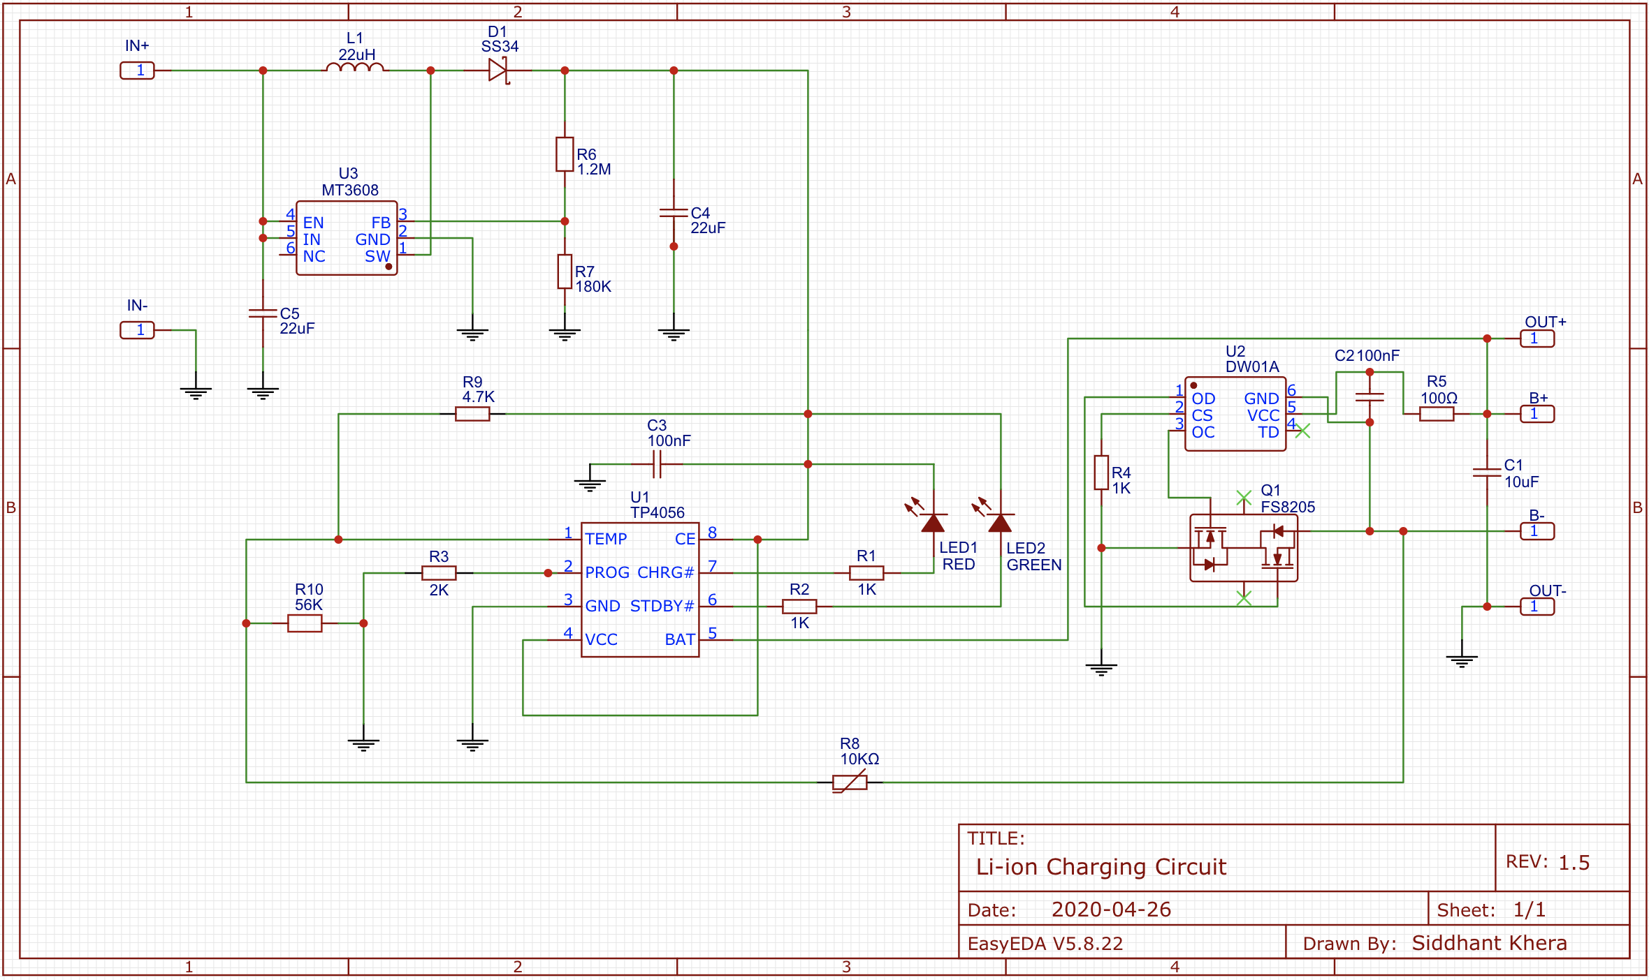
Fig 11: Final Li-ion Charging Circuit [10]

Slide 23
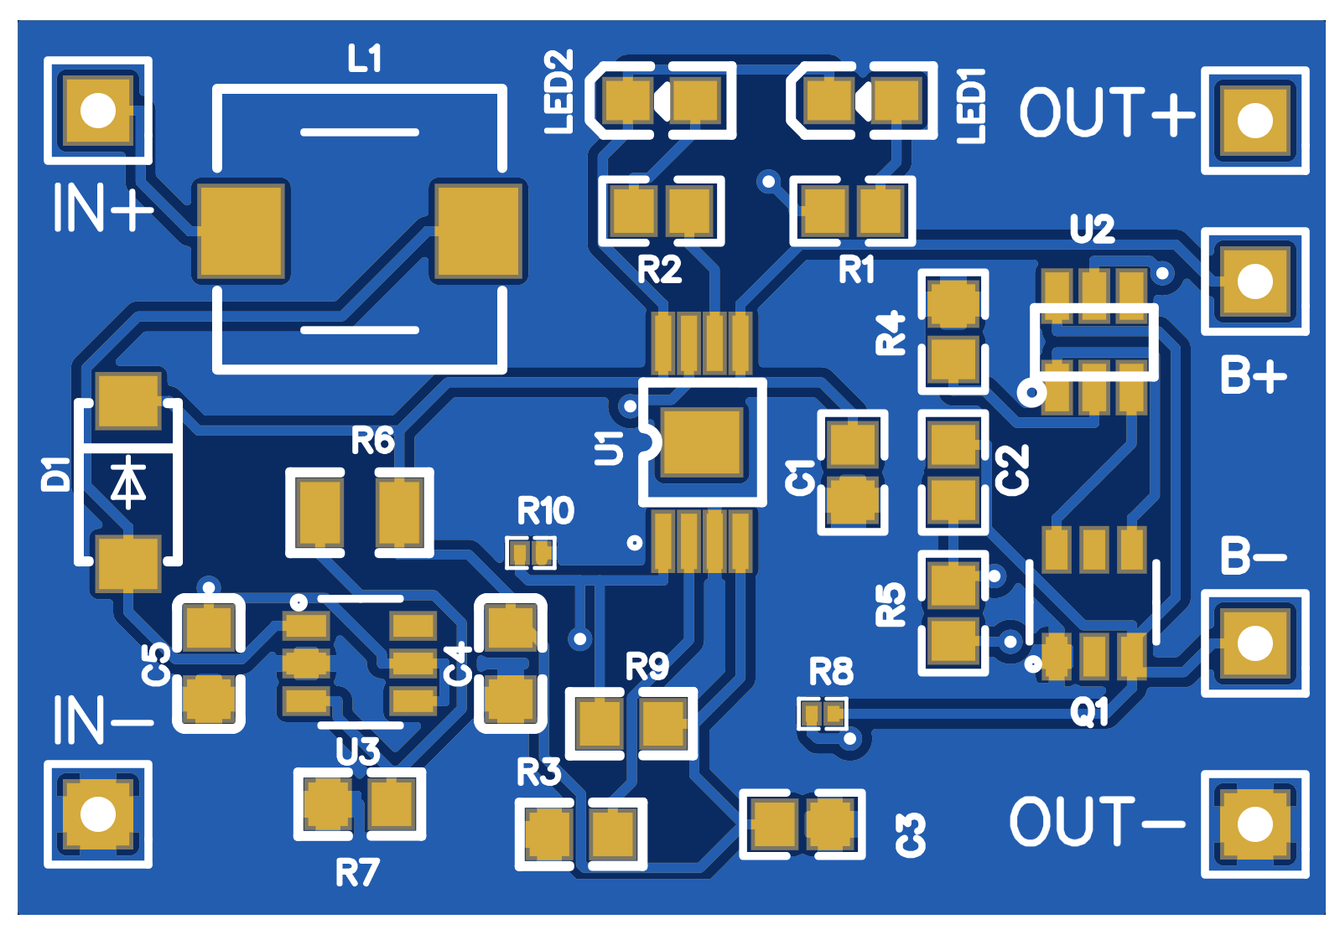
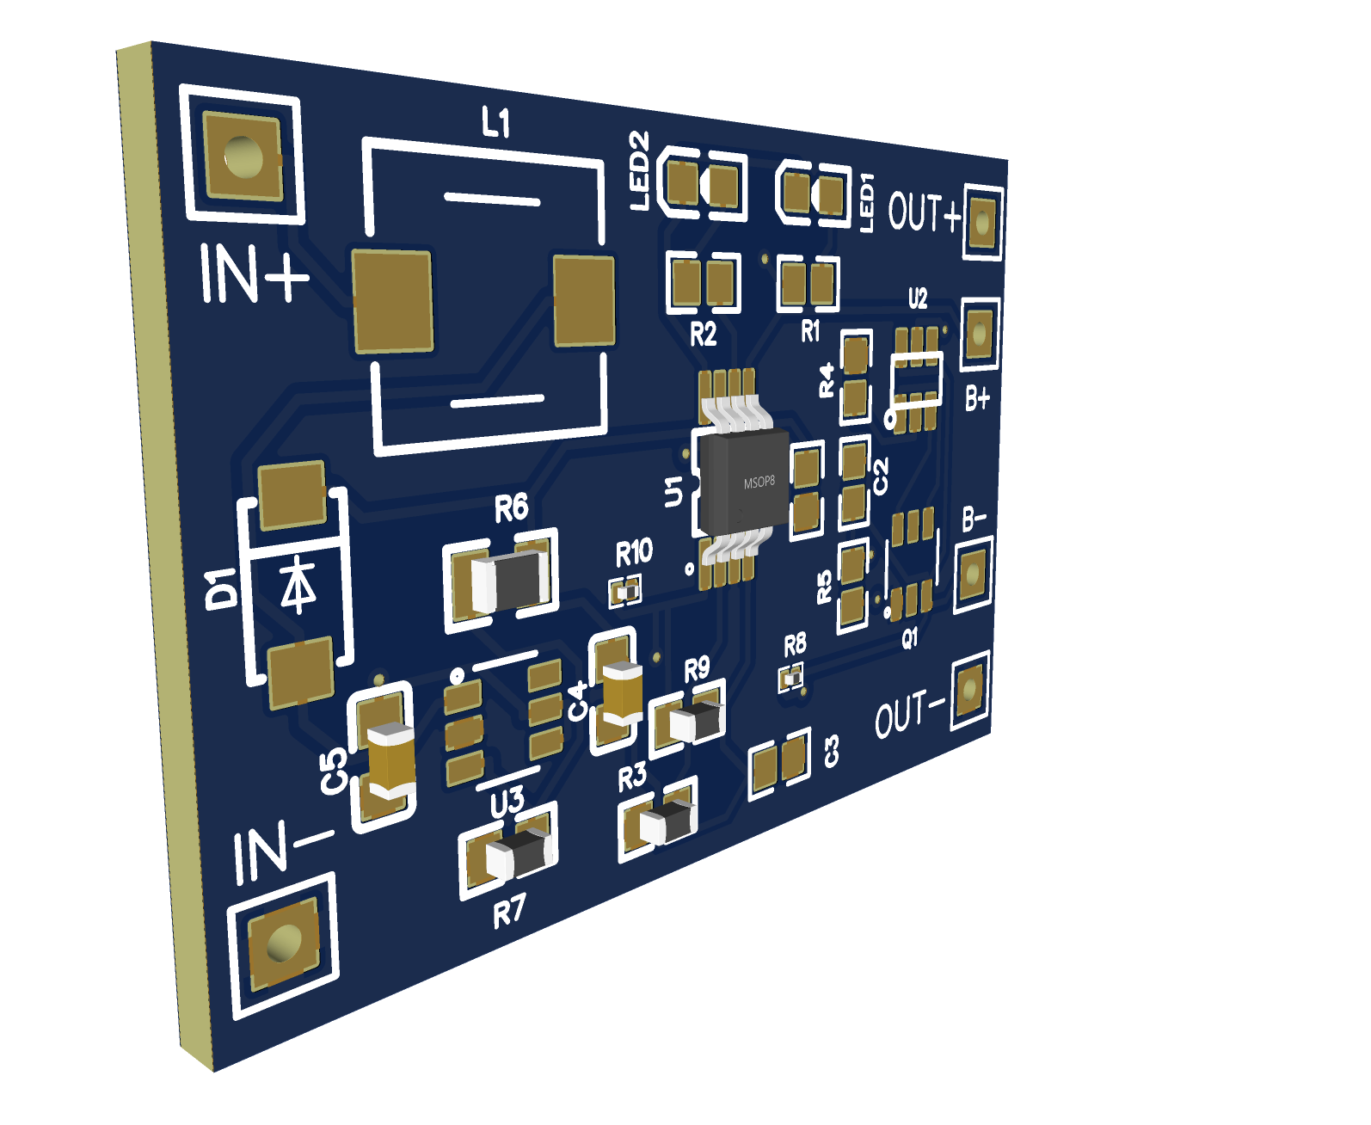
Printed Circuit Board (PCB)
Allows for small size in the enclosure
Single PCB instead of multiple ones
Drives down manufacturing cost
Trace width = 25mm, allows for testing up to 1A
Hardest: Placing components to manage traces and routing
Costs $0.03 to manufacture, $0.18 with assembly for manufacturer (could be cheaper)
Fig 12: Photo View of PCB [10]
Fig 13: 3D View of PCB [10]

Slide 24
Drawbacks of current design
Lacks reverse polarity protection
Load cannot be connected with the battery simultaneously

Slide 25
Enclosure
Goals:
IP64 or greater
Dust-tight
Waterproof –– Splashed water from any angle [11]
≤ $1
Made for outdoor use
UV radiation
Heat
Impacts
Project Requirements
≤ 100mm x 60mm x 60 mm
-40 ºC to 85 ºC
Notes:
IP rating: http://www.dsmt.com/resources/ip-rating-chart/

Slide 26
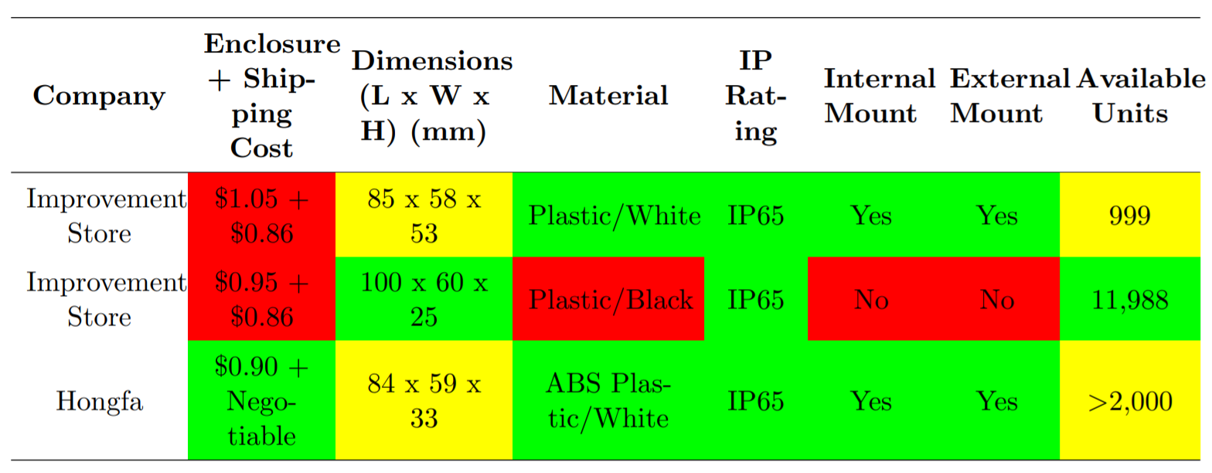
Enclosure
Table 4: Enclosure Decision Matrix [8]

Slide 27
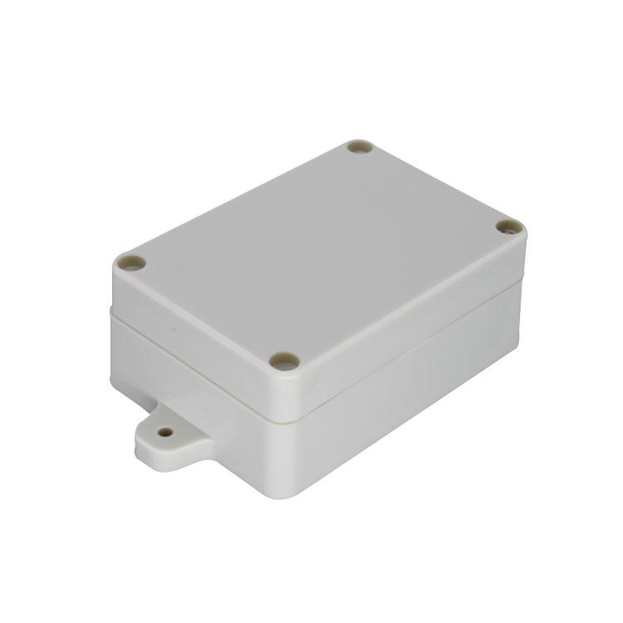
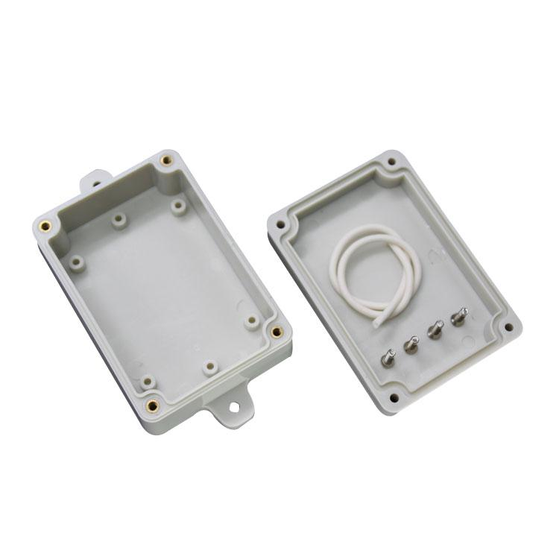
Enclosure
Final Choice: Hongfa
84 x 59 x 33 mm
Made for outdoor use
ABS plastic, white
Recyclable [13]
IP65
$0.90 + negotiable shipping
Fig 14: Closed view [8]
Fig 15: Open view [8]
Notes:
enclosure photos: https://www.alibaba.com/product-detail/ABS-Outdoor-plastic-electronic-enclosure-waterproof_60667174101.html
abs is recyclable: https://www.plasticsinsight.com/resin-intelligence/resin-prices/abs-plastic/

Slide 28
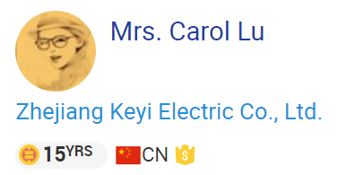

Enclosure
Cost improvement!
Contacted seller
Four 1.8mm holes
$0.558
FOB: free on board
Fig 16: Seller profile
Fig 17: Message from seller

Slide 29
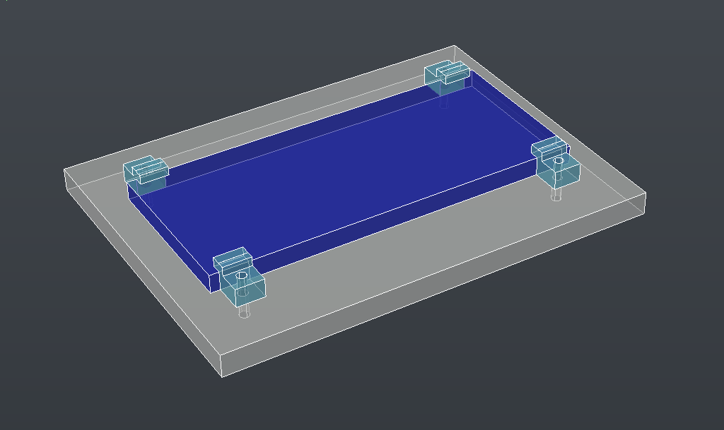
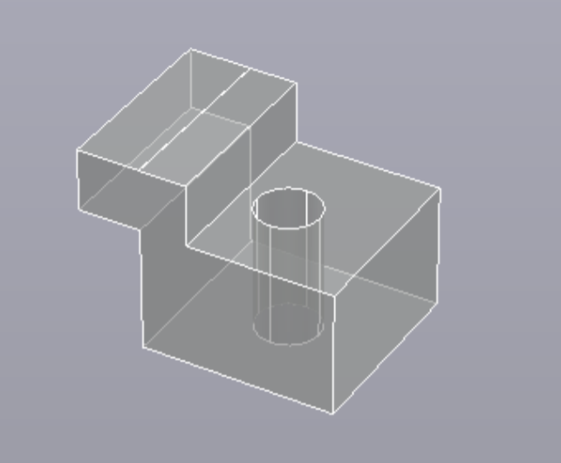
Enclosure
How to mount the solar panel?
Custom High Density Polyethylene (HDPE) holders
2 x 4mm screws
Use sealant to water and dust proof holes (see our Final Report for more details)
Fig 18: Mounted solar panel on enclosure lid (right) [8]
Fig 19: Holders

Slide 30
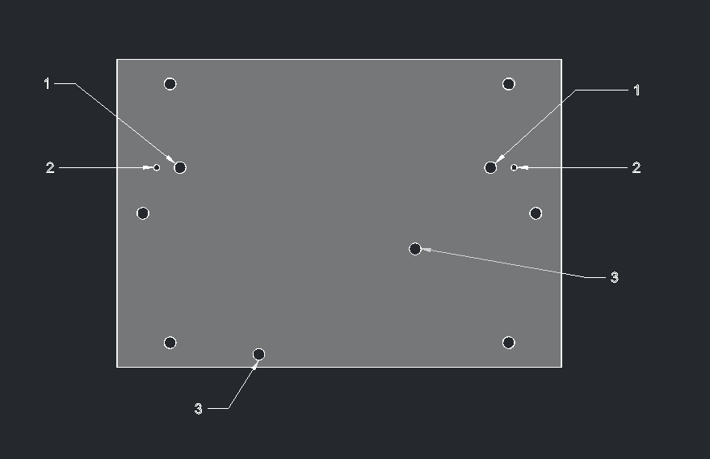
Enclosure
Mounting internal components
PCB and battery holder
HDPE mounting plate
$0.0075/unit [8]
2 x 4 mm screws
Fig 20: Mounting plate - holes:
Battery holder
Battery leads
PCB
All other holes: mount plate to enclosure [8]

Slide 31
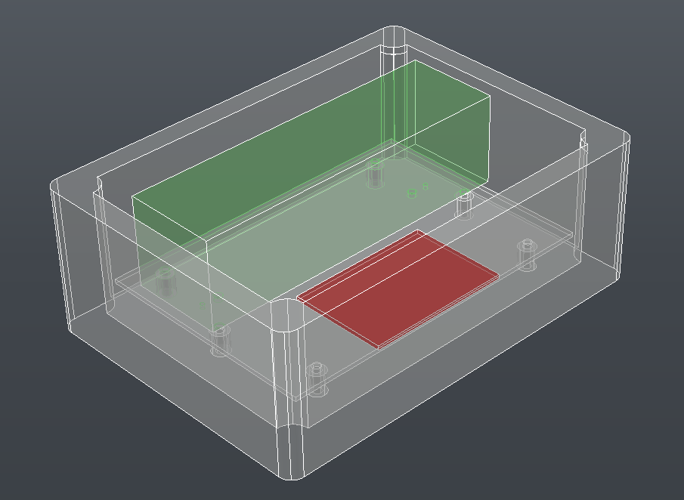
Final
Enclosure
Fig 21: View of internal mounted components [8]

Slide 32
Bill of Materials
Overall our BOM in total came out to $2.92, which was better than Xylem’s requirement of maximum $3 for high-volume production of the circuit and enclosure.
Used wholesale companies in order to purchase our components
AliExpress
LCSC Electronics
Alibaba
JCL PCB
Cheapest components to mention
DW01A (Battery Protection IC): $0.029 for 10,000+ units (LCSC Electronics)
Most expensive component:
Enclosure: $0.558 for 1000+ units
Shipping is negotiable in bulk orders (A plus)
In order to stay below the $3 threshold we made many changes and compromises
Change in suppliers

Slide 33
Ethical Engineering
Is the topic: Ethics, subjective?
Least-cost or most humane design?
Are we exploiting Humans to enrich other Humans’ lives?
Where do we draw the Moral line?
Child labor? Forced Labor? Mistreatment of Laborers?

Slide 34
Conclusions
Through teamwork, research, and perseverance we were able to meet and exceed the design requirements for the energy harvester. We were able to design a system using an alternative energy source - solar that will give power to a water meter. In our system we included
Protections against temperatures and for our battery
Ensures the health and safety of the consumers
Our design is also
Environmentally friendly
Has manufacturability - can be reproduced on larger scales
So, what can we improve in the future?

Slide 35
Future work
Improved Enclosure
Using aluminum instead of plastic
Can add heat sinks to the sides
Helps cool down the battery
Note: Aluminum is usually more expensive than plastic
Would require more time customizing an aluminum enclosure and heat sinks that fit in our budget
Physically Produced Prototype
Beneficial in allowing us to test in different weather conditions
Propose a functioning prototype that can be used for commercial purposes

Slide 36
Future work
Obtaining SPICE for Simulation
Without SPICE libraries we were unable to prove our design worked at all
In the future we would need access to these libraries to simulate
Sourcing Design from Nations with Effective Labor Laws
Most of our project was sourced in China
With more time, and in the future we would look into sourcing from other nations with strict labor laws
Uphold ethics as engineers

Slide 37
References
[1] S. unielec, “Thermoelectric Power Generator Ultra Thermal Conductive,” March 2020. [Online]. Available: https://www.ebay.com/ itm/1pcs-Thermoelectric-Power-Generator-Ultra-Thermal-Conductive-TEG-27145-/152641213248
[2] “BUHUSHUI 5V 25MA Mini Solar Panels.” Aliexpress.com, www.aliexpress.com/item/32827162063.html.
[3] NSRDB Data Viewer, National Renewable Energy Laboratory, maps.nrel.gov/nsrdb-viewer/?aL=0&bL=clight&cE=0&lR=0&mC=4.740675384778373%2C22.8515625&zL=2.
[4] Scottburnham. “Renewable Energy Under City Streets: Generating Power from City Water Pipes.” REPROGRAMMING THE CITY, 29 June 2019, reprogrammingthecity.com/generating-power-from-city-water-infrastructure/.
[5] “Thermoelectric Power Generator TEG Module SP1848-27145 Philippines - Makerlab Electronics.” Makerlab Electronics, www.makerlab-electronics.com/product/thermoelectric-power-generator-module-teg-sp1848-27145/.
[6] Cloudfront.net, “TP4056 1A Standalone Linear Li-lon Battery Charger with Thermal Regulation in SOP-8,” March 2020. [Online]. Available: https://dlnmh9ip6v2uc.cloudfront. net/datasheets/Prototyping/TP4056.pdf

Slide 38
References
[7] Microchip, “MCP73831 Datasheet –– Miniature Single-Cell, Fully Integrated Li- Ion, Li-Polymer Charge Management Controllers,” January 2020. [Online]. Available: http://ww1.microchip.com/downloads/en/DeviceDoc/20001984g.pdf
[8] S. Khera, S. LaFave, K. Bakr, “EE494: Final Design Review,” The State University of New York, University at Buffalo, Spring 2020. [Online]. Available: https://www.ublearns.blackboard.com
[9] www.aliexpress.com, “Wholesale price 18650 battery 3.7V li-ion rechargeable battery 1200mah 1500mah 1800mah 2000mah 2200mah 2600mah,” May 2020. [Online]. Available: https://www.aliexpress.com/item/32893018458.html
[10] www.aliexpress.com, “Solar Cell 5.5V Mini Solar System 70mA,” May 2020. [Online]. Available: https://www.aliexpress.com/item/33009866599.html
[11] www.iprating.com, “ IP Rating Chart: Learn what IP means and what rating is best for your application” May 2020. [Online]. Available:http://www.dsmt.com/resources/ip-rating-chart/
[12] www.alibaba.com, “ABS Outdoor plastic electronic enclosure waterproof IP65 junction box” May 2020. [Online]. Available: https://www.alibaba.com/product-detail/ABS-Outdoor-plastic-electronic-enclosure-waterproof_60667174101.html
[13] www.plasticsinsight.com, “ABS Plastic Production, Price and Market Demand,” May 2020. [Online]. Available: https://www.plasticsinsight.com/resin-intelligence/resin-prices/ abs-plastic/

